Slide 1
Phlebotomy at
BCCC
YOU BELONG HERE

Slide 2
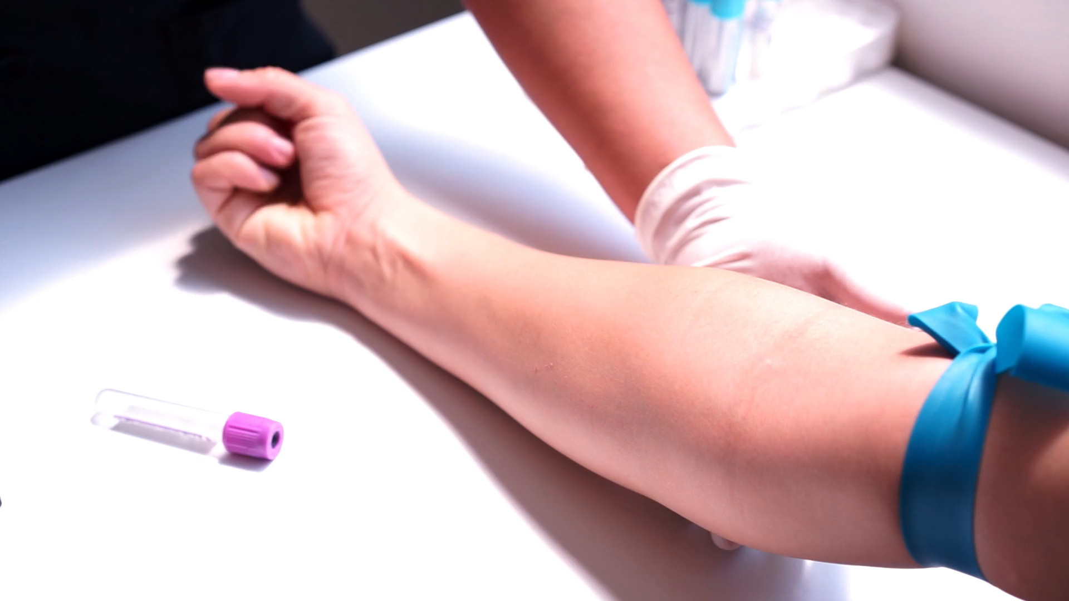
Phlebotomists are healthcare professionals trained to take venipuncture/blood specimens for testing or donation.
What is a Phlebotomist?
Los Muertos Crew

Slide 3

Employment Opportunities
Hospital
Physician Clinic
Blood/Plasma Donor Clinic
NC average starting pay rate is $15/hr.
Video by Artem Podrez from Pexels

Slide 4
Phlebotomy-Let’s get started
Prerequisites: Career Readiness Certificate (CRC) of Silver or Higher, High school transcript or High School Equivalency
Other options: College degree, or a Math and English college course with at least a C.
CRC link for more information- BCCC NCRC Testing Information
Register in Building 8. Payment and prerequisites are due at the time of registration. Financial/scholarship assistance may be available. Call 252-940-6375
Registration and Payment
Financial Assistance
Program requirements are discussed in detail on the first day of class.

Slide 5


Program Requirements
Hybrid course with online instruction. Student will need to be able to access Blackboard and attend in person for class, lab and clinical instruction.
Student is responsible for: books, background check, immunizations, drug testing, and transportation to clinical site(s).
Course requires 95 hours of clinical experience at a clinical facility. Clinical facilities require a background check, drug testing, and current immunizations.
Student is responsible for purchasing CastleBranch. CastleBranch is a 3rd party vendor used for background check, drug testing and immunization documentation ($90). Convictions or unsubstantiated drug tests are reviewed and determined by the clinical facility. Clinical facility decision is final.
Student is responsible for purchasing Rotation Manager. Rotation Manager ensures student compliance with clinical facility. ($29)
Student is responsible for ensuring immunizations are up-to-date. Cost will vary depending on immunizations needed.
Uniform: Price will vary depending on your place of purchase.
https://discover.castlebranch.com/
https://rotationmanager.com/

Slide 6

Phlebotomy
Credentialing
Individuals completing the Phlebotomy Program are encouraged to take a national certification exam.
ASPT is a National Certifying Agency.
https://www.aspt.org/

Slide 7
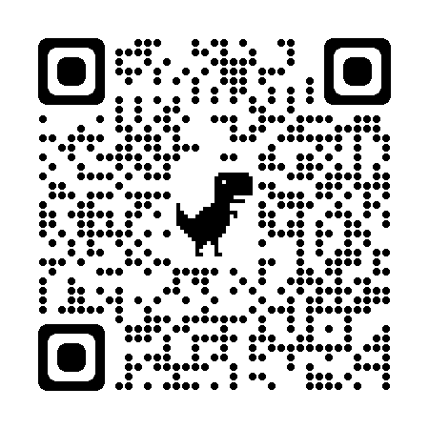
Phlebotomy
Registration-$180, Course fees-$24.25
Contact Continuing Education for Scholarship Information
Continuing Education
252-940-6375 or 252-940-6263
Email: continuingeducation@beaufortccc.edu
jackie.butcher@beaufortccc.edu
Listed below are links to our website to assist you.
Registration and Payment
Financial Assistance
Class Schedules

