Slide 1
Cardiovascular Monitor Technician at BCCC
YOU BELONG HERE

Slide 2
What is a Cardiovascular Monitor Technician? A valued member of the health care team responsible for surveillance of patient cardiac monitors. Technician will perform EKG test to monitor and record cardiac activity. The technician is able to read and measure the patient’s rhythm strips and notify changes to healthcare providers. Responsibilities of a Cardiovascular Monitor Technician: Observe cardiac monitors to note changes in a patient’s baseline heart pattern. Perform clerical duties of documenting patient information and evaluation.
Cardiovascular Monitor Technician

Slide 3
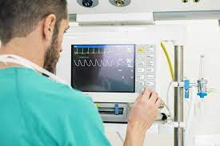
Employment Opportunities
Hospital
Physician clinic
Specialized cardiac clinic
NC average starting pay rate is $15-17/hr.

Slide 4
Cardiovascular Monitor Technician: Let’s get started
Prerequisites: High School Diploma or Equivalency, Career Readiness Certificate (CRC) of Silver or Higher Other options: College degree, or a Math and English college course with at least a C.
CRC link for more information - BCCC NCRC Testing Information
Register in Building 8. Payment and prerequisites are due at the time of registration. Financial/scholarship assistance may be available. Call 252-940-6375
Registration and Payment
Financial Assistance
Program requirements are discussed in detail on the first day of class.

Slide 5
Program Requirements
Hybrid course of online instruction. Student will need to be able to access Blackboard and attend in person for CPR and clinical instruction in Part II.
Student is responsible for: books, background check, immunizations, drug testing, and transportation to clinical site(s).
Course requires clinical experience at an acute care facility. Clinical facilities require a background check, drug testing, and current immunizations. Clinical sites require a 3rd party vendor for documentation compliance.
Student is responsible for purchasing CastleBranch. CastleBranch is a 3rd party vendor used for background check, drug testing and immunization documentation Convictions or unsubstantiated drug tests are reviewed and determined by the clinical facility. Clinical facility decision is final.
Student is responsible for ensuring immunizations are up-to-date. Cost will vary depending on immunizations needed.
Uniform: Price will vary depending on your place of purchase.
https://discover.castlebranch.com/

Slide 6
Cardiovascular Monitor Technician Credentialing
Successfully complete program to be eligible to test with ASPT.
https://www.aspt.org

Slide 7
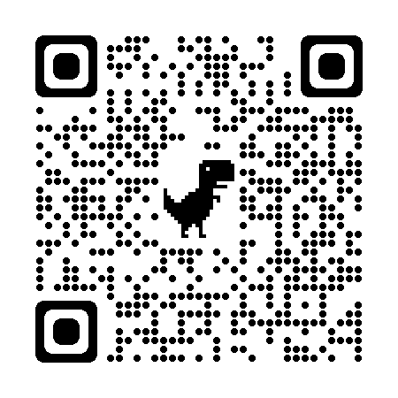
Cardiovascular Technician Part I- Registration-$190 Part II- Registration-$194.25 Contact Continuing Education for Scholarship Information
Continuing Education
252-940-6375 or 252-940-6263
Email: continuingeducation@beaufortccc.edu
jackie.butcher@beaufortccc.edu
Listed below are links to our website to assist you.
Registration and Payment
Financial Assistance
Class Schedules

