Slide 1
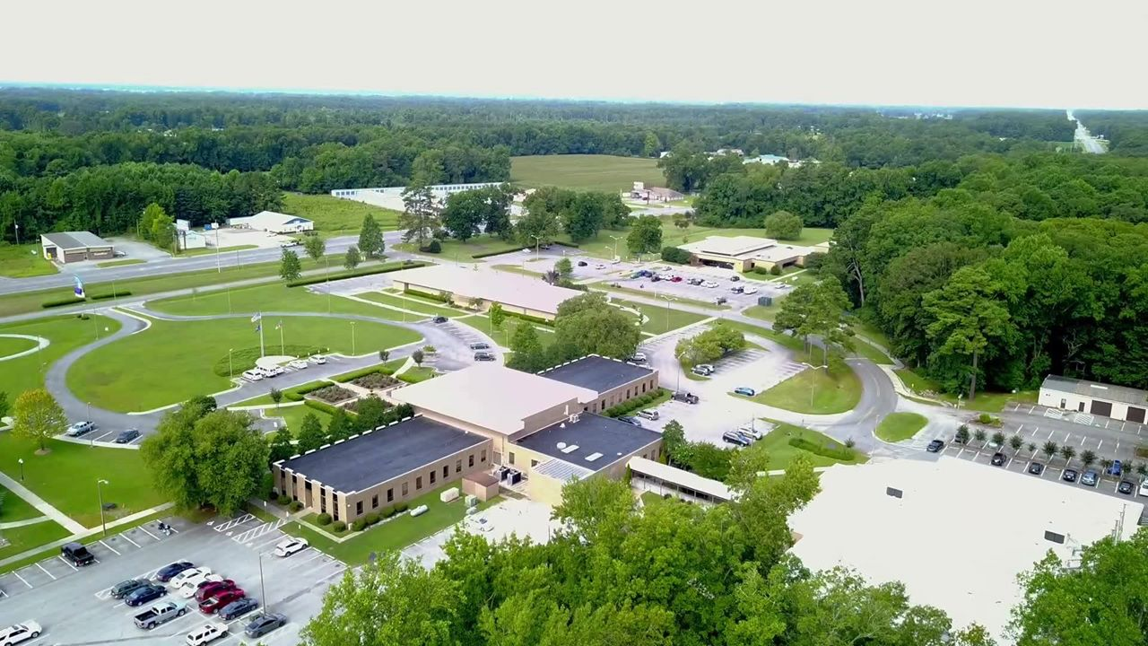


Beaufort
County
Community
College
You belong here!

Slide 2


Welcome to New Student Orientation
Today marks the beginning of your journey toward success, and we are here to support you every step of the way.
What to Expect from New Student Orientation (NSO)
Connect: Meet the NSO Leadership team.
Explore: Discover the resources and facilities available to you.
Learn: Get the inside scoop on navigating your first semester.
Succeed: Set the foundation for your academic and career goals.

Slide 3
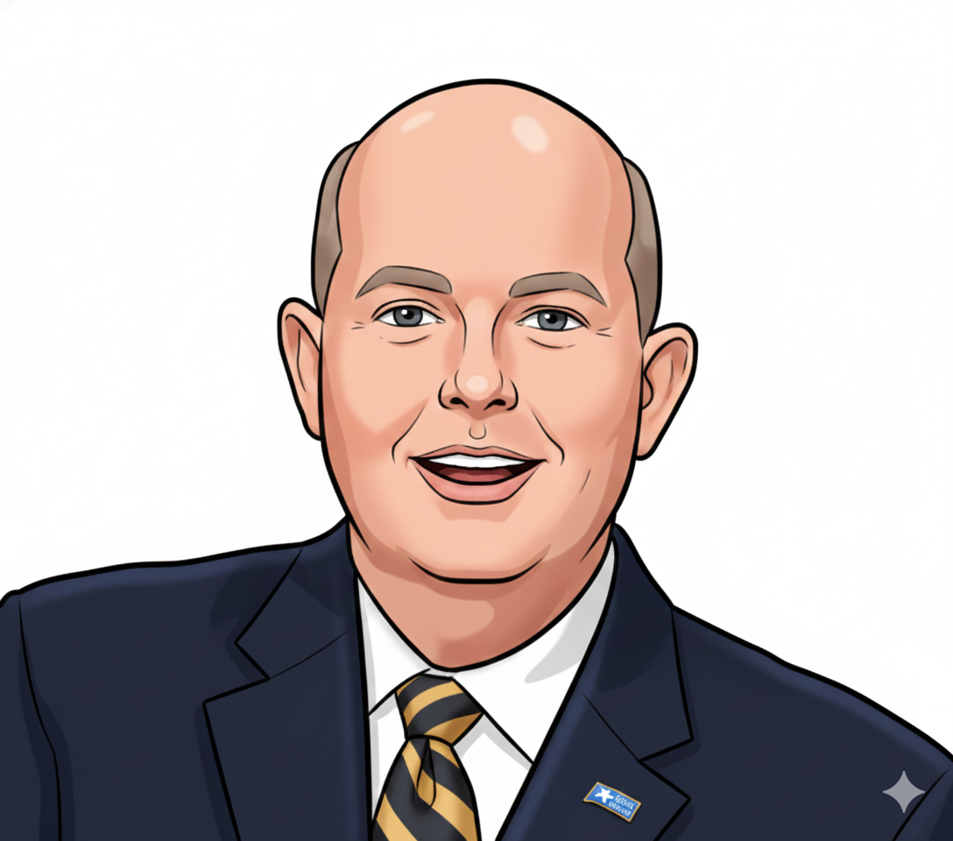

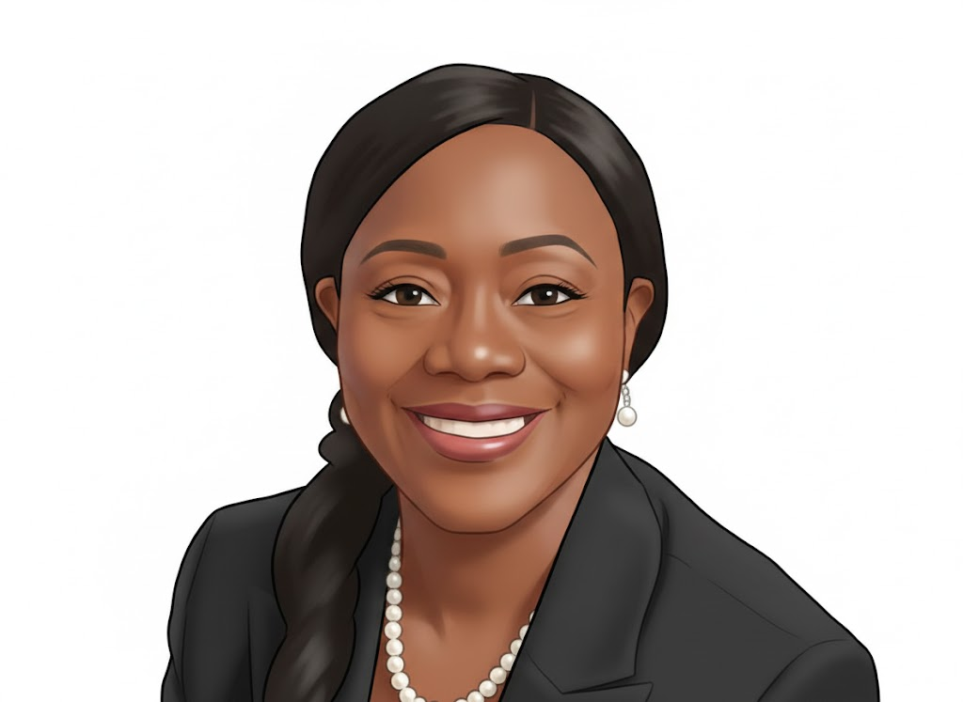
Dr. Dave Loope, President
Meet the NSO Leadership Team
Click on each picture to hear a few words of wisdom and encouragement.
Dr. Lisa Hill
Dr. LaTonya Nixon
EVP of Instruction and Workforce Development
VP of Student Services

Slide 4






Your Accounts
Email and
Microsoft 365
Canvas
Self Service
Transcripts
Canvas is our learning management system that is used in all classes. To learn more about navigating Canvas, check out the Passport course in Canvas.
Self Service is an online platform used for registration, financial aid, and billing. Click here for more information.
Official transcripts from BCCC are available through National Student Clearinghouse.
Click here to learn more about accessing your BCCC email and other helpful resources.
UED | Profile

Slide 5

Your Resources
Use these resources to ensure your success!!
Centralized
Advising Center
Learning Enhancement Center
BCCC Library
Clubs and
Organizations

Slide 6

CENTRALIZED ADVISING CENTER (CAC)
At BCCC, you will receive one-on-one advising from academic advisors who care about your success!
Registration
We’re Here to Help
Registering for Classes for Your First Semester
Your advisor will help you select and register for classes using Self Service and the curriculum checklist for your program of study. Your advisor will register you for your first semester classes.
Registering for Classes After Your First Semester
During your first semester at BCCC, you will take a College Success course (ACA-111 or ACA-122) where you will create an Academic Course Plan that aligns with your career and personal goals. With your advisor’s guidance, you will choose courses and build a proposed schedule in Self-Service. Your advisor must approve your proposed class schedule before you can register for classes.
High School Students
All high school students complete advising and registration activities through their high school liaison.
  Which program of study is right for me?
  Who is my advisor?
  How can I see the course schedule?
  How do I register for classes in Self Service?

Slide 7
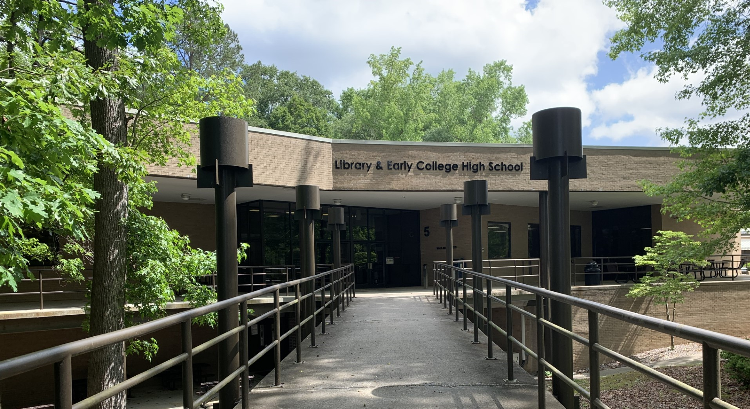

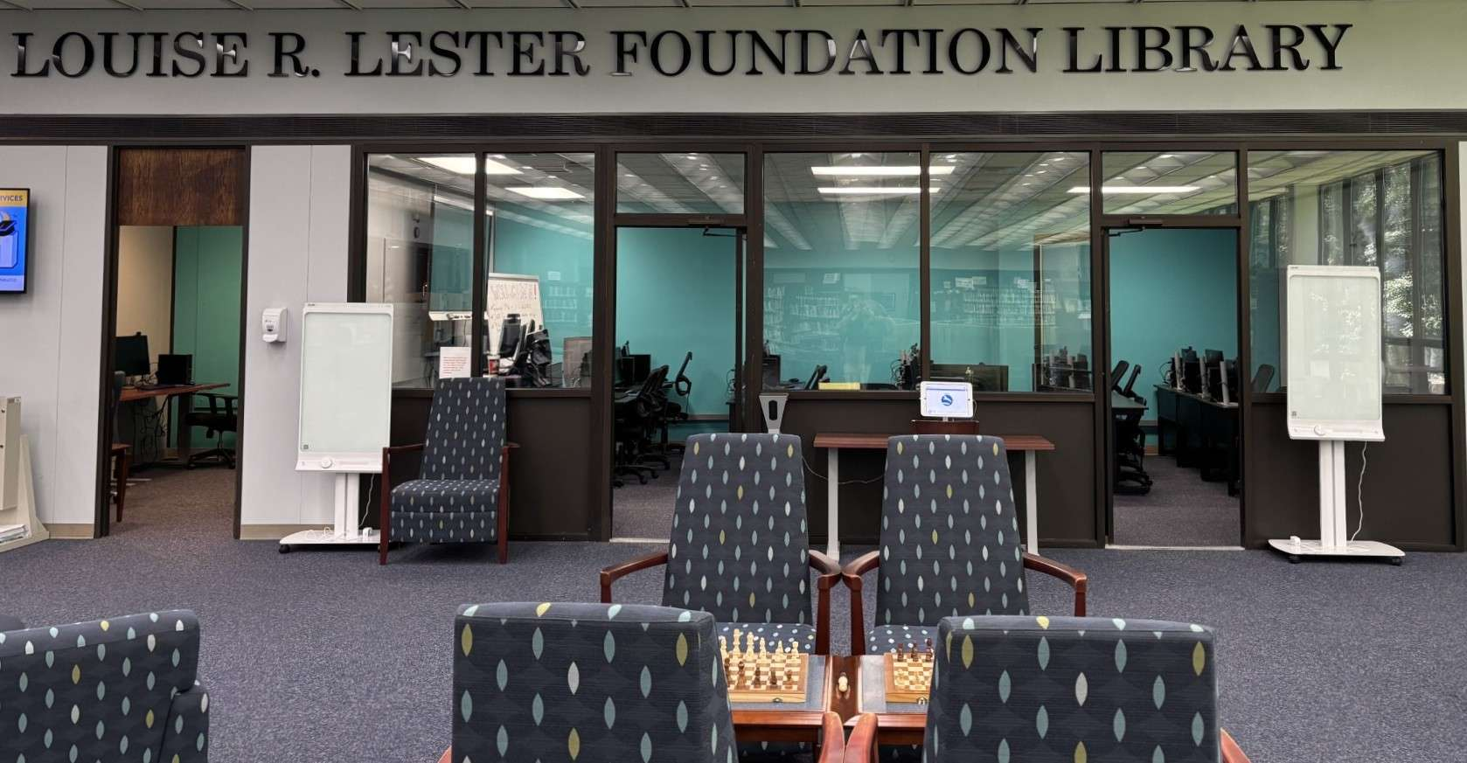
BCCC Lester Library
The Lester Library at Beaufort County Community College supports the educational goals, objectives, and academic programs of the college. We provide access to many information resources and collections suitable for lifelong learning and research. We also have a beautiful space where library users can come to study and relax. We hope to see you soon!
For Online Inquiry & Discovery:
Library Webpage
Search the online catalog (Evergreen)
Library Card Application
Research Consultations: Schedule an in-person research help session for finding, evaluating, and/or citing sources (30 minutes). We can also meet you virtually if you can’t come to campus.

Slide 8
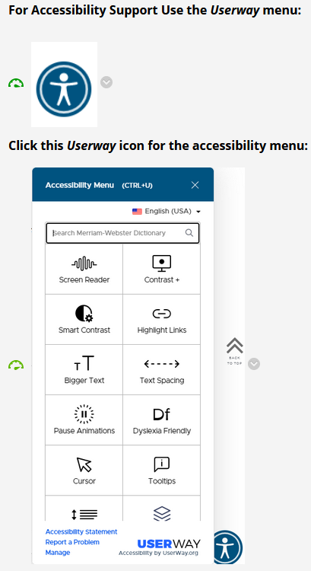
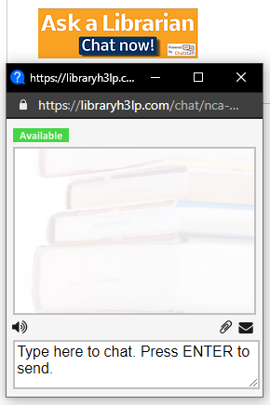


Additional BCCC Library Resources
Whether you’re learning on campus or online, we have additional resources for you.
Hoopla and
Dogwood Digital
24/7 Librarian Chatbot

Slide 9
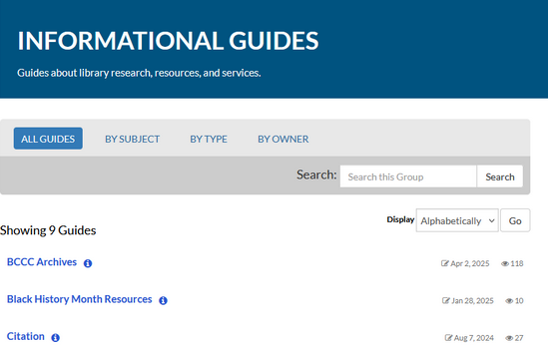
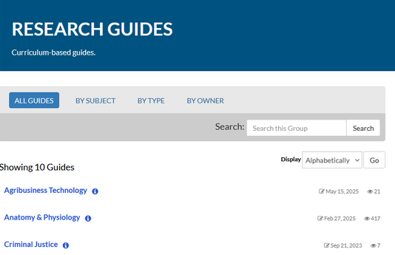

Libguides
LibGuides are websites that feature library resources and educational content intended for faculty, students, and other researchers. Guides are either informational (guides about library research, resources, and services) or research (specific curriculum-based guides).
You can find these under "Resources" on the library homepage.

Slide 10

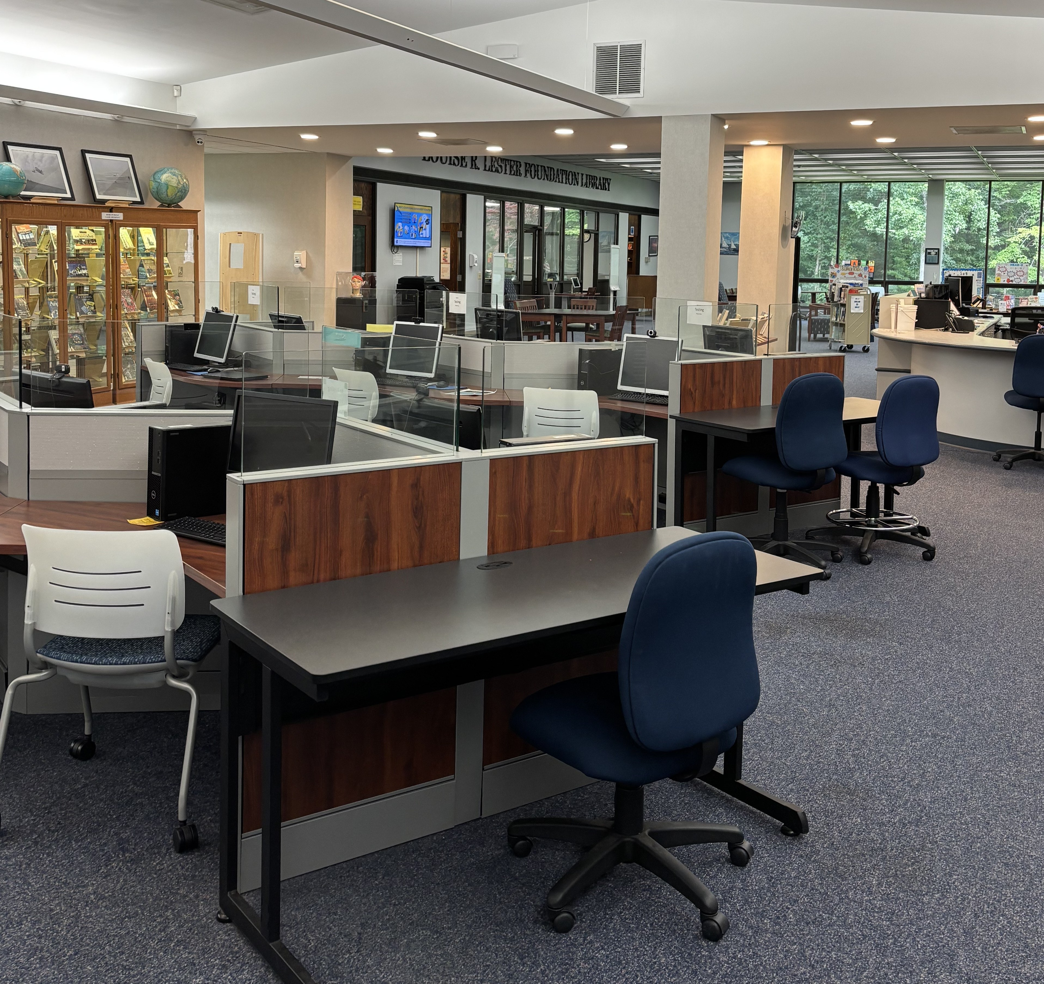
The Louise R. Lester
Foundation Library
is here to help you
succeed!
Contact BCCC Louise R. Lester Library:
Circulation Desk Phone: (252) 940-6282
Email: Library@Beaufortccc.edu
Beaufort County Community College
Louise R. Lester Library
Building 5, Upper Level
5337 U.S. Hwy 264 East
Washington, NC 27889

Slide 11

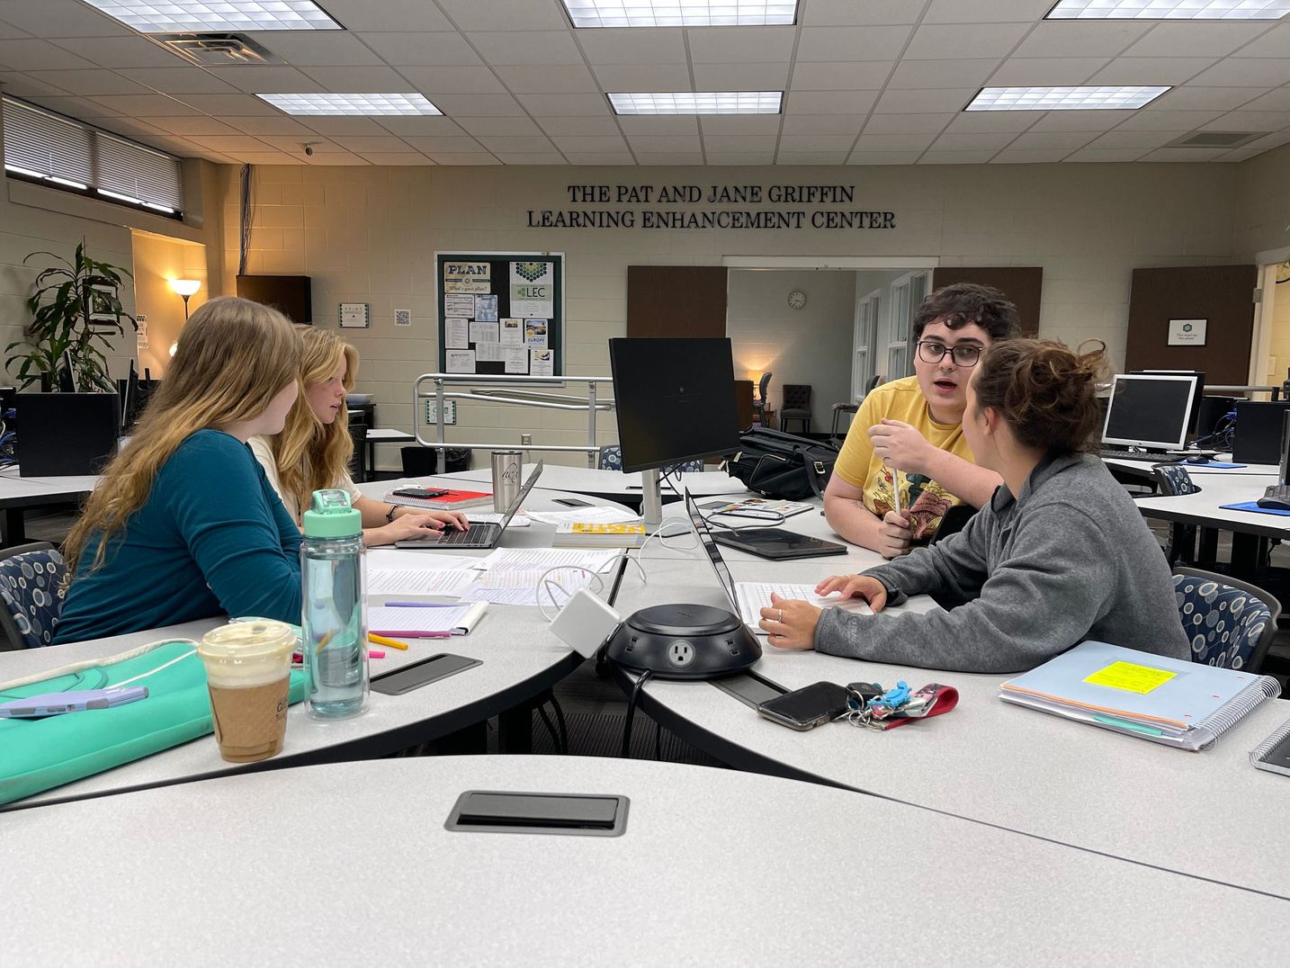



  The BCCC Learning Enhancement Center (LEC) is open, by referral, to all students enrolled in a curriculum course. Offering a comfortable atmosphere and a convenient schedule, the LEC helps students make connections, discover solutions, and build skills for academic success.
  LEC Website
  View Tutoring Schedule
  Schedule an LEC Appointment
  The LEC also provides online assistance for our distance learning students via Tutor.com.
  James E. Casey
  Director of LEC

Slide 12

Clubs and Organizations
  Automotive Club
  Beaufort County Association of Nursing Students
  Chess Club
  Environmental Alliance
  Gamma Beta Phi
  Jeremiah 29
  LGBTQ+ Club
  Life on the Pamlico
  Mechanical Engineering Club
  Medical Lab Technology Club
  Men of Success
  Music Club
  Student Government Association
  Students Striving to Succeed through Leadership
  Study Abroad
  Welding Club
  Writing Club
  BCCC offers a wide range of student clubs and organizations, so there’s something for everyone. Whether your interests include leadership, study abroad, writing, or chess, you can find a group that fits you. Getting involved is a great way to enhance your college experience, develop new skills, and connect with others who share your interests.
  Don’t see a club you like? Start your own and make it happen!

Slide 13

Your Services
Reach out to the offices below. We are here to help!
Admissions and Records
TRIO
Support Services
Financial Aid

Slide 14
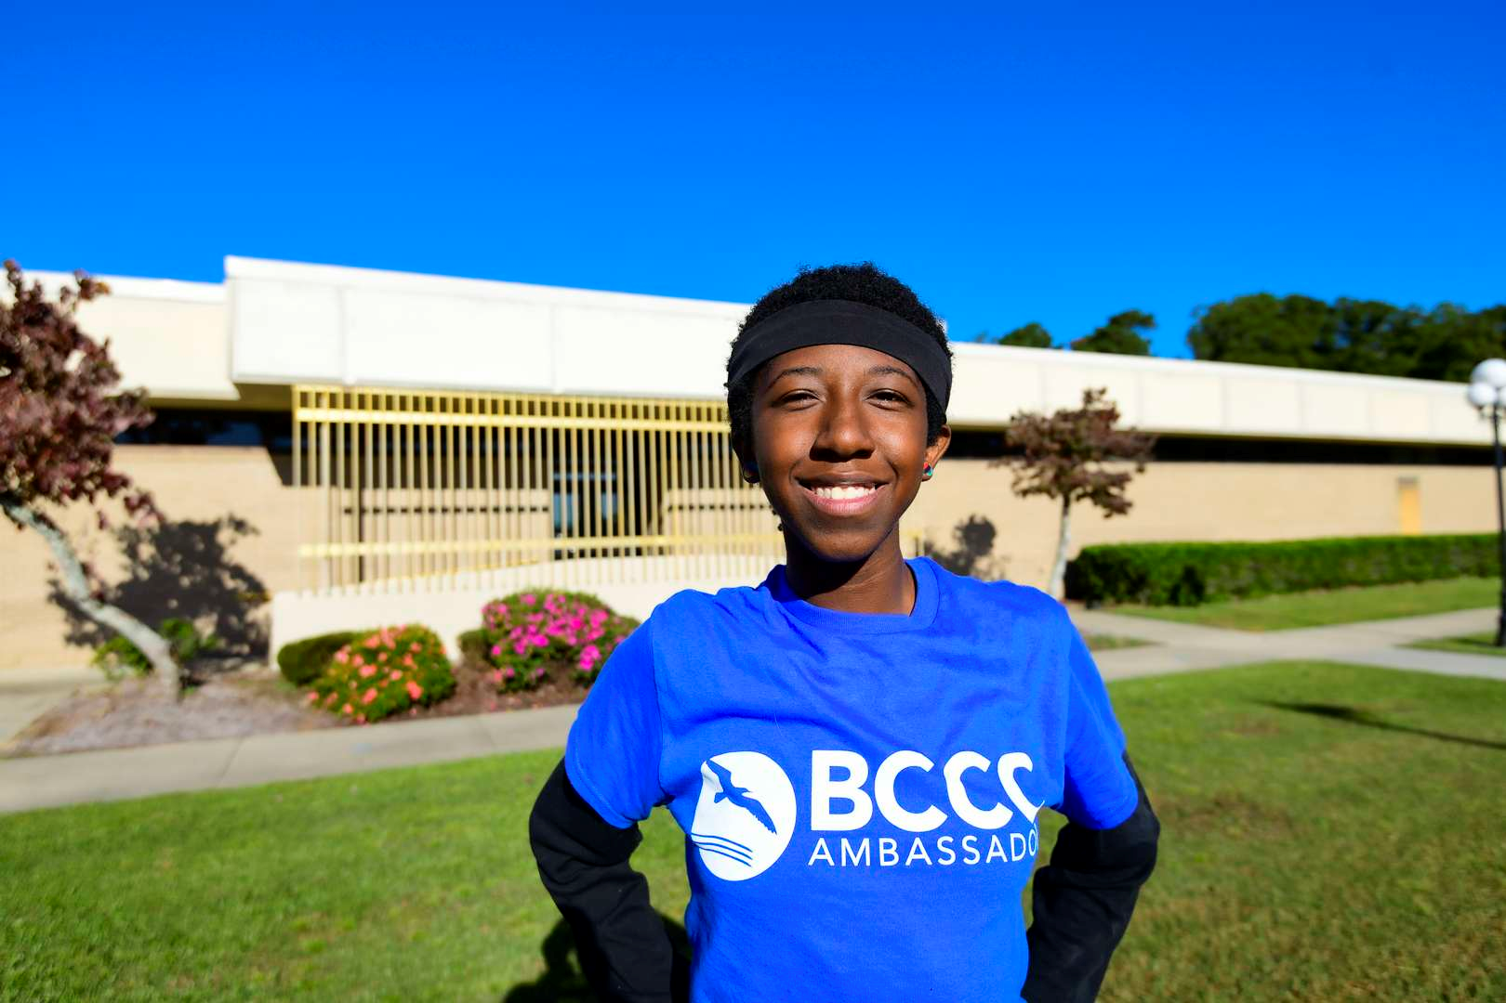
Admissions and Records
The Admissions and Records staff are thrilled to welcome you to campus!
We can assist you with the following:
Apply to BCCC
Complete Residency
Changes in program of study, contact information, and residency
Transcript Requests
Allied Health programs have a separate, competitive admissions process and application. Check the Allied Health page for deadlines, admission testing information, and prerequisite course requirements.
For information on allied health programs, contact our Allied Health Coordinator.
General Admissions
(252) 940-6237
Admissions@Beaufortccc.edu
Building 9
Allied Health Admissions Coordinator
(252) 940-6431
Building 3

Slide 15


  Need help paying for college? Make sure to fill out your FAFSA every year! This application helps us determine the financial aid available to you.
Free Application for Federal Student Aid
Financial Aid
  Visit studentaid.gov and complete your FAFSA by June 1st.
  Keep an eye on the financial aid checklist in Self Service to ensure you’ve completed all requirements.
  Check your BCCC email daily for updates.
  NOTE: Even if you do not think you qualify for need-based funding, complete the FAFSA anyway because it is required for most scholarships and grants, including Beaufort Promise!
  BCCC FAFSA School Code: 008545
Financial Aid Office
Building 9
(252) 940-6222
Finaid@Beaufortccc.edu
Financial Aid Website

Slide 16
TRIO Support Services
Free TRIO Services
  TRIO, funded by the U. S. Department of Education, offers support to students in community and four year colleges.
  Our goal is to empower students with tools that will help them continue in school until graduation or transfer to a four-year institution.
  Become part of the TRiO family today!
  Tutoring
  Academic Coaching
  Educational Planning
  University Transfer Support and Campus Visits
  Financial Literacy
  Career Planning and Professional Development
  Scholarship Opportunities
  Technology Loan Program
  Leadership Development
  Access to the Student Success Center
  Educational Opportunities
  Study Groups
For more information, contact
Dr. LaTonya Nixon
(252) 940-6216
LaTonya.Nixon@Beaufortccc.edu
Building 9, Office 919

Slide 17
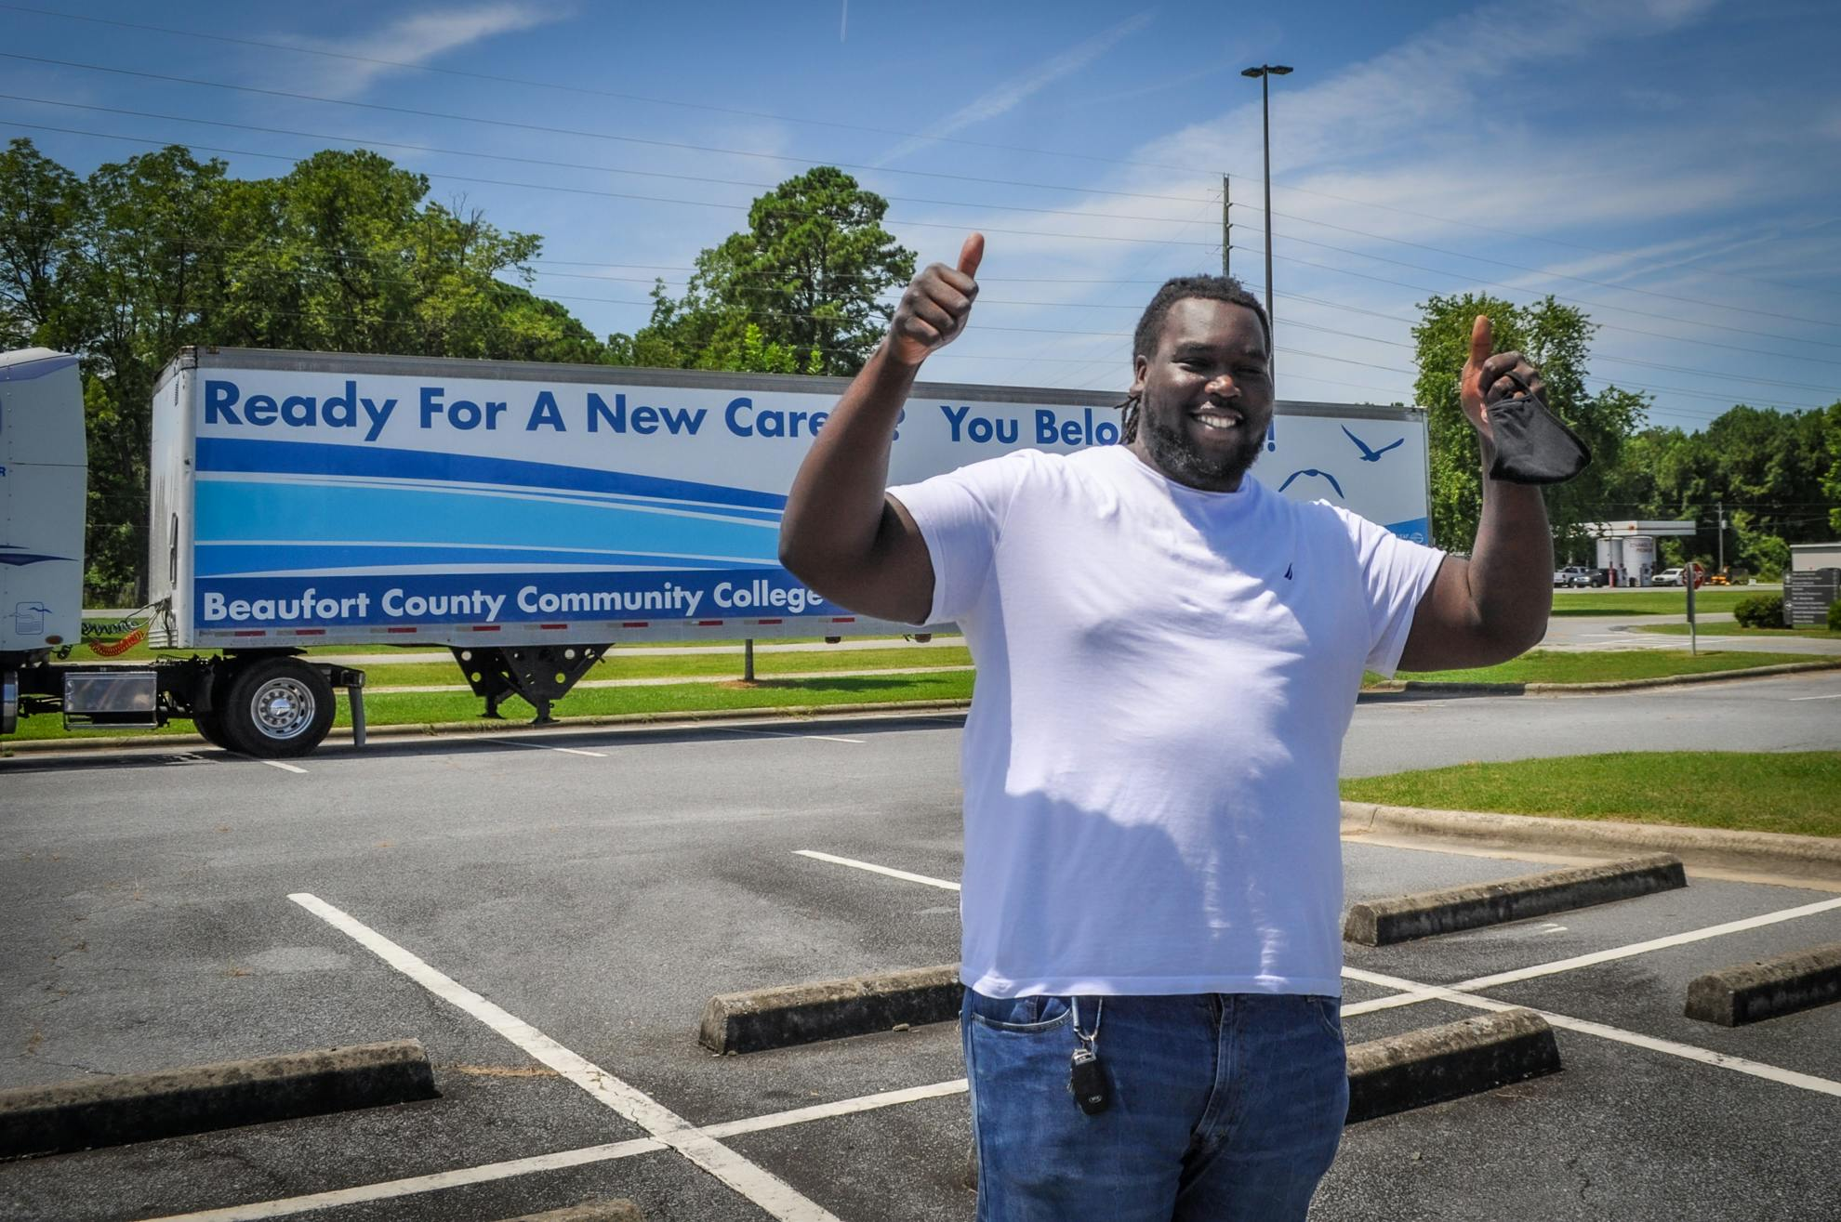
Your Support
Reach out to your support team today!
Counseling
Center
Accessibility
Services
CARE Team
Title IX

Slide 18
The Counseling Center offers a variety of services to
meet students’ academic, personal, and vocational needs.
Services include, but are not limited to, the following:
Setting goals
Establishing or improving study habits
Evaluating academic standing
Short-term personal counseling
Improving relationships and building a support system
Exploring self-care options
Connecting with resources on and off campus
Assisting with transfer degree planning
Career counseling/planning including resume and interview prep
Providing placement test information, proctoring, and interpretation of results
Hosting workshops designed to meet students’ needs
Assisting with food insecurities
Counseling
Center
Kimberly Jackson
Building 9-925
(252) 940-6252
Kimberly.Jackson@Beaufortccc.edu
Jamie Cohick
Building 9-924
(252) 940-6443
Jamie.Cohick@Beaufortccc.edu
Confidentiality
Most information shared with our counselors is kept confidential. Only with your
consent will we release information to anyone outside BCCC’s Counseling Center,
except as required by law. Legal exceptions include:
Clear and imminent danger to yourself or others
Court Order

Slide 19
Accessibility Services
Special Services
  Interpreters for the hearing impaired
  Auxiliary aids
  Testing modifications
  Securing alternative text
  Academic planning
  It is our goal to promote equal access in all campus programs, activities, and events for individuals with disabilities through universal design and inclusive environments. Our Accessibility Services Coordinator (ASC) is dedicated to supporting students with a qualified disability in their quest for higher education.
Steps to Apply
  Complete the application here.
  Contact the ASC, Jahmar Bradby
  (252) 940-6313 or Jahmar.Bradby@Beaufortccc.edu Building 9-923
  Provide required disability documentation.
  Meet with the ASC to determine reasonable accommodations.
  Provide accommodation letters to instructors.
Eligibility
  Eligible students must:
Have a physical or mental impairment that substantially limits one or more major life activities, such as caring for one’s self, performing manual tasks, walking, seeing, hearing, speaking, breathing, or learning
Have a record of such an impairment
Click here to review the general documentation guidelines for Accessibility Services.

Slide 20
Campus Assessment Responsive Evaluation (CARE) Team
The CARE Team is a multidisciplinary group of college personnel focused on resource connection and campus safety.
Goals
Team Members
Promoting a safe physical environment for members of the college community.
Promoting a safe emotional environment for the college community.
Promoting peace of mind for friends and family of the college community.
Through CARE, students, staff, faculty, and community members can refer individuals to our CARE team for intervention and support.
The motto of CARE is "If you see something, say something".
Dr. LaTonya Nixon, Vice President of Student Services
William Chrismon, Chief of Police
Ann Barnes, Lead Instructor of Human Services
Nicole Johnson, Director of Human Resources
Kimberly Jackson, Director of Counseling
Penelope Radcliffe, Director of Career and College Readiness
Click here to submit a referral to the CARE Team.

Slide 21
Title IX
What is Title IX?
Title IX of the Education Amendments of 1972 prohibits sex discrimination in educational programs and activities. It states, "No person in the United States shall, on the basis of sex, be excluded from participation in, be denied the benefits of, or be subjected to discrimination under any education program or activity receiving Federal financial assistance.“
What should be reported to the Title IX Coordinator?
Any prohibited forms of sexual misconduct should be reported, regardless of whether they take place on or off campus. Prohibited forms of sexual misconduct include: domestic violence, dating violence, stalking, sexual harassment, sexual assault, rape, and sexual exploitation. Definitions for each of these appear in our Title IX Policy 6.22.
What is the reporting process?
BCCC strongly encourages all members of the campus community to report gender discrimination, including sexual misconduct, that impacts the educational environment (whether it takes place on or off of campus). Upon receiving a report, the College will take appropriate steps to provide support to the alleged victim, investigate the incident, and conduct a fair adjudication process.
To submit the Title IX Gender Discrimination and Sexual Misconduct Anonymous Reporting form, click here or contact the Title IX Coordinator for Students.
Nicole Johnson
(252) 940-6204
Nicole.Johnson@Beaufortccc.edu
Building 1, Office 114C

Slide 22
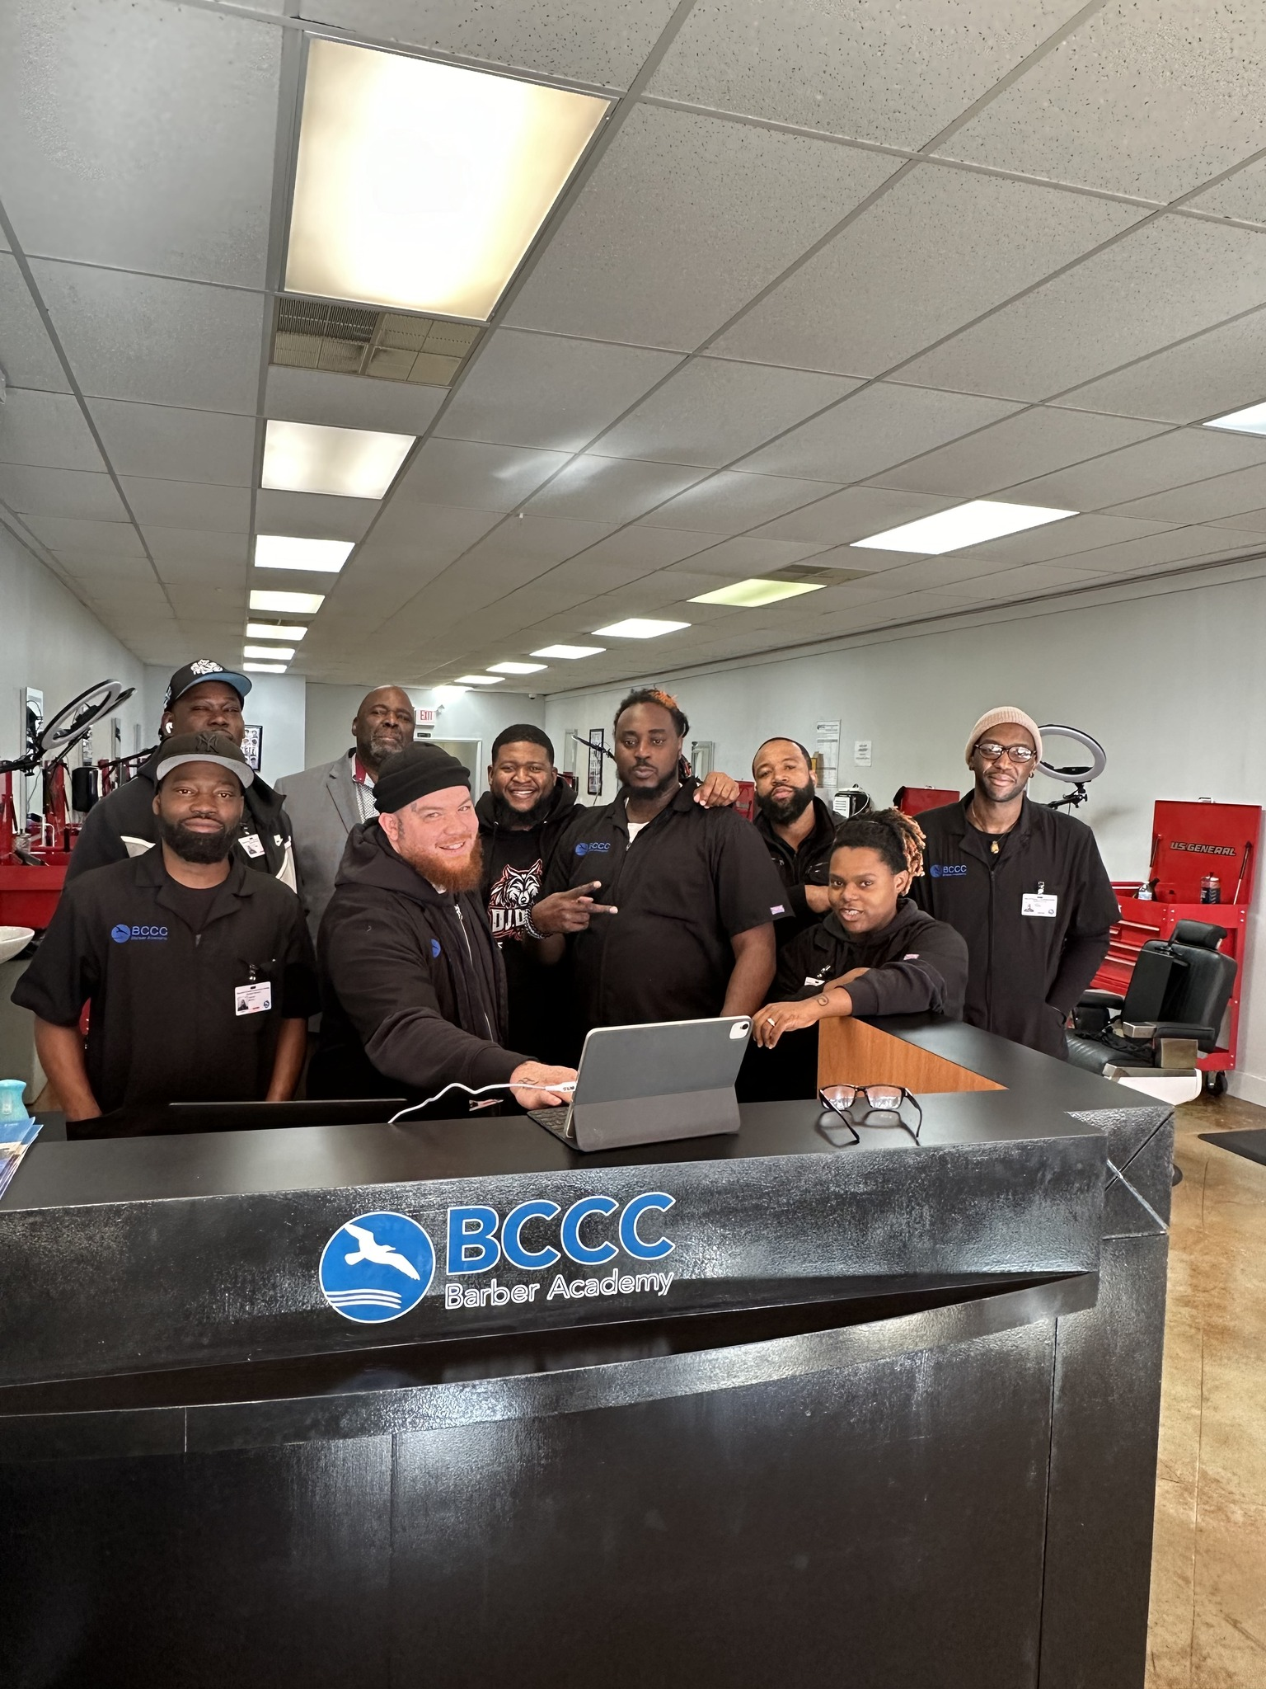
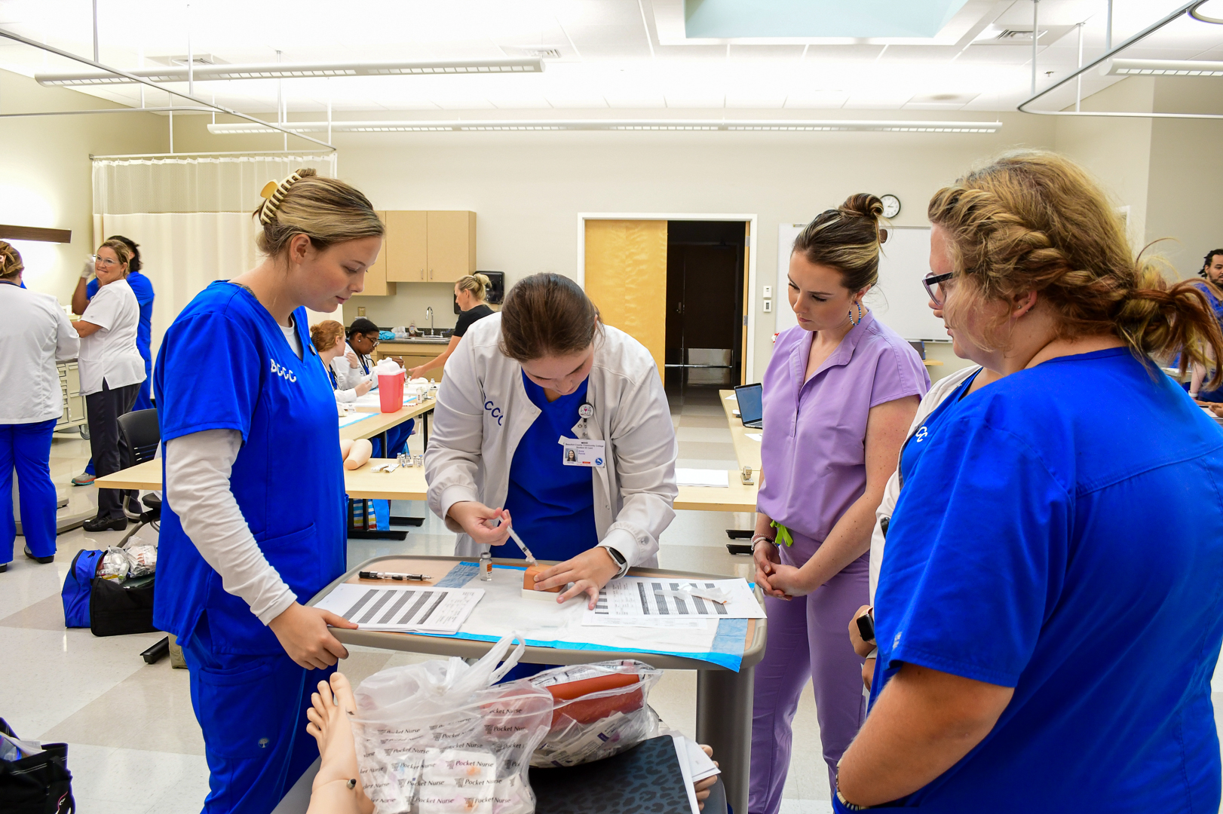
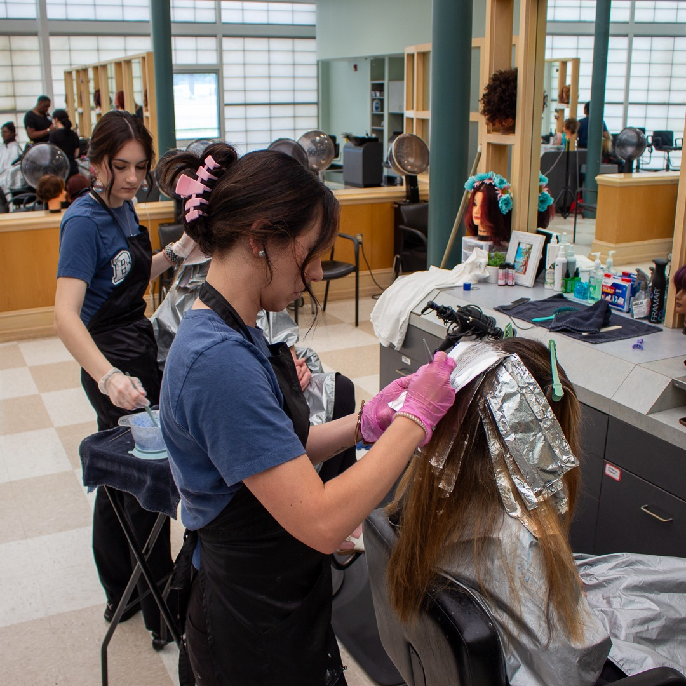
Congratulations! You’ve completed New Student Orientation!

